Slide 1
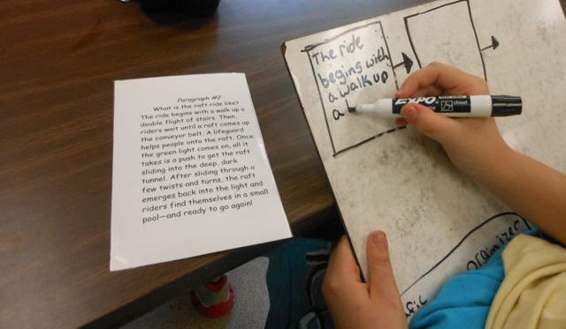
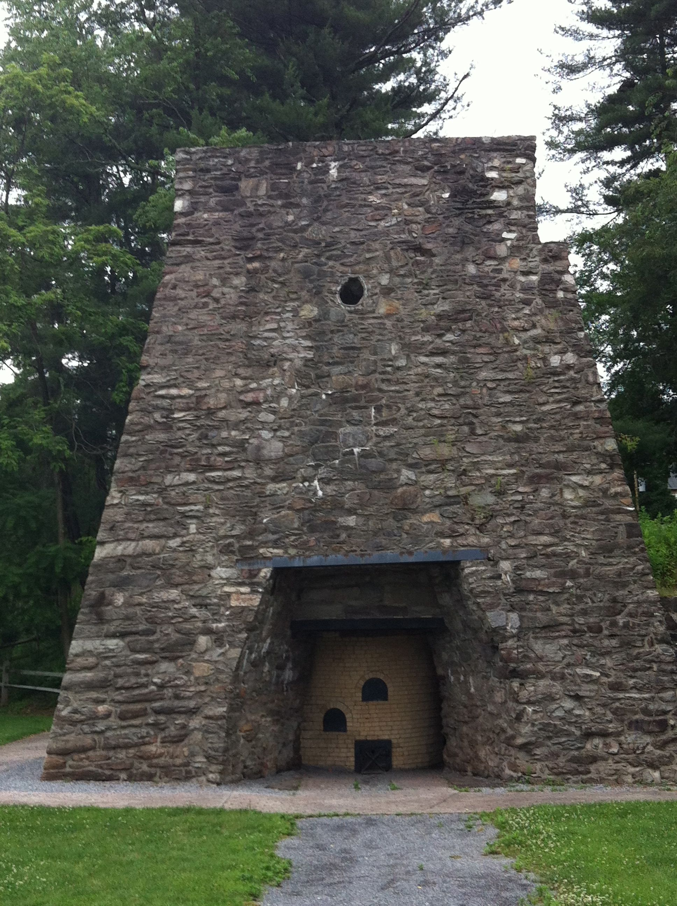
Identifying Text Structures
Notes:
By Emily Kissner, including all photos.

Slide 2
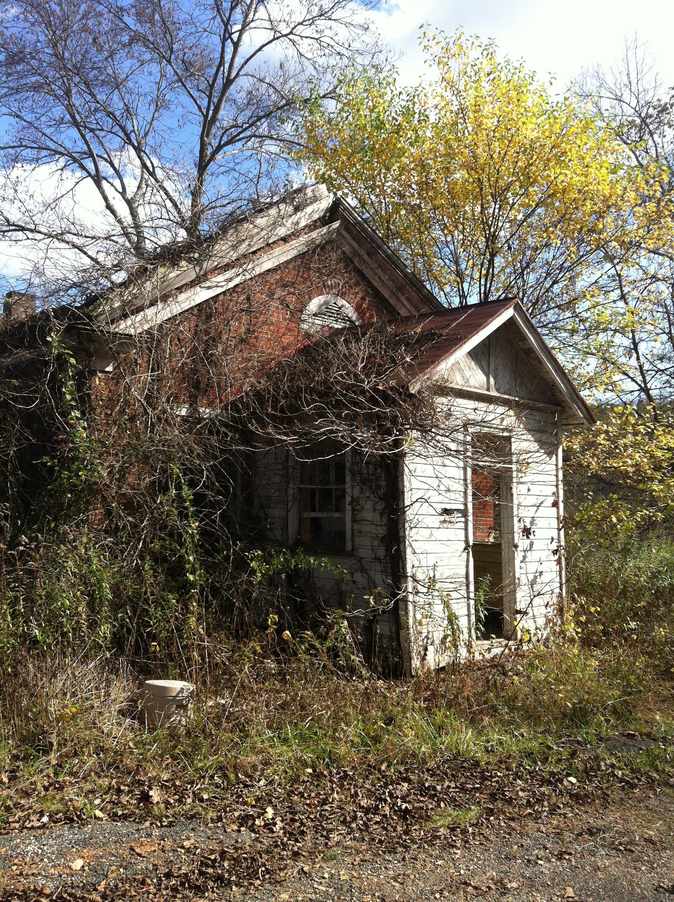
Text structures we’ve learned about
Chronological order
Compare and contrast
Cause and effect
Problem and solution
Description

Slide 3
Clue words #1
Can you figure out the text structure that these clue words point to?
however, on the other hand, similarity, like, unlike

Slide 4
Clue words #2
Can you figure out the text structure that these clue words point to?
as a result, consequently, therefore, so, cause, effect

Slide 5
Clue words #3
Can you figure out the text structure that these clue words point to?
problem, solution, threat, difficulty, hope, answer, possibility

Slide 6
What’s the text structure? #4
Daniel Sullivan was the first to notice the flames coming from the O’Leary barn at around 8:30 pm on October 8. A problem with the alarm box made it impossible for the people in the area to call for the fire department. By 9:30 pm, the entire block was blazing. In another 3 hours, there were fires all over Chicago. The heavy wind coming from the lake only made the fire bigger. It would be another day before the fire would be completely out. By that time, 17,500 buildings had been burned.
Chronological order
Compare and contrast
Cause and effect
Problem and solution
Description

Slide 7
What’s the text structure? #5
Chronological order
Compare and contrast
Cause and effect
Problem and solution
Description
Why was the Great Chicago Fire so disastrous? After all, Chicago had fire departments and fire alarms. One reason for the terrible fire is that the alarm malfunctioned. The local fire company noticed the fire by accident as it was returning from another fire. As another problem, a watchman who saw the flames directed other fire companies to a location that was nearly a mile away from the fire. Because of these two problems, a fire that could have been controlled rapidly spread across the city.

Slide 8
What’s the text structure? #6
After the fire, thousands of people were left homeless. Many escaped the fire with nothing except the clothes on their backs. Providing all of these people with food, clean water, and shelter was a huge task. Luckily, the city quickly formed a Relief and Aid Society. This group started giving out the food donations that were pouring in from other cities. The society built places for people to live, gathered the tools that people needed to rebuild their houses, and even vaccinated 64,000 people against smallpox.
Chronological order
Compare and contrast
Cause and effect
Problem and solution
Description

Slide 9
What’s the text structure? #7
Chicago changed in many ways after the fire. Before the fire, most of the buildings were less than five stories high. The buildings that were constructed after the fire, however, were some of the first skyscrapers in the country. Before the fire, most of the houses were made of wood. After the fire, people chose to build their houses out of stone or brick. There were changes in where people lived, as well. The poor people in the city lived close to the center of the city before the fire. After the fire, they moved into neighborhoods that were farther away from the downtown area.
Chronological order
Compare and contrast
Cause and effect
Problem and solution
Description

Slide 10
What’s the text structure? #8
By Monday night, the town of Chicago was burning. People described it as terrible, but amazing. The flames were brighter than anything people had ever seen. The harsh winds swept the fire across the city with terrible speed. For many who watched, it was a sight to remember for the rest of their lives.
Chronological order
Compare and contrast
Cause and effect
Problem and solution
Description

Slide 11
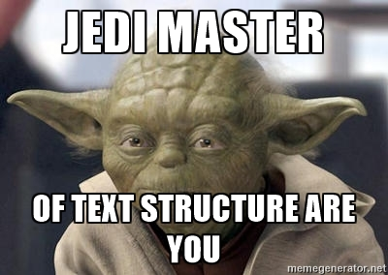
Bring your 8 answers to class tomorrow to find out if you’re a master of text structures!
Notes:
Text and photos by Emily Kissner. You may share and remix for non-commercial use.
http://creativecommons.org/licenses/by-nc/3.0/deed.en_US

