Slide 1
Students will be able to determine the main idea of a text; recount the key details and explain how they support the main idea. Lafs.4. RI.1.2

Slide 2
Main Idea

Slide 3
When we read, we may often find ourselves asking questions like “What am I supposed to understand from this passage?”, What’s this text about?” “What is the main topic?” Most of you are familiar with finding the main topic of a passage , but now we are going to learn about Main Idea. Third grade is the first time Main Idea is introduced, so today’s lesson is very important.

Slide 13
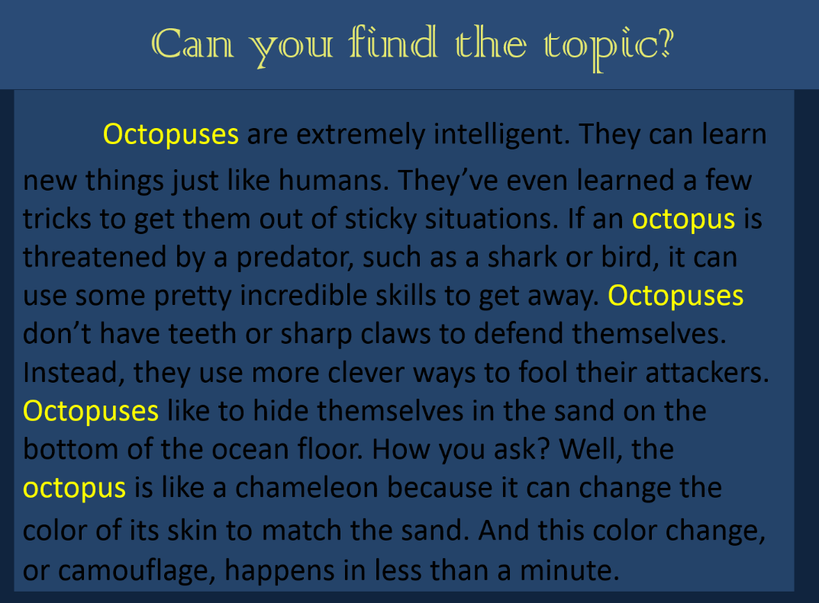

Slide 44
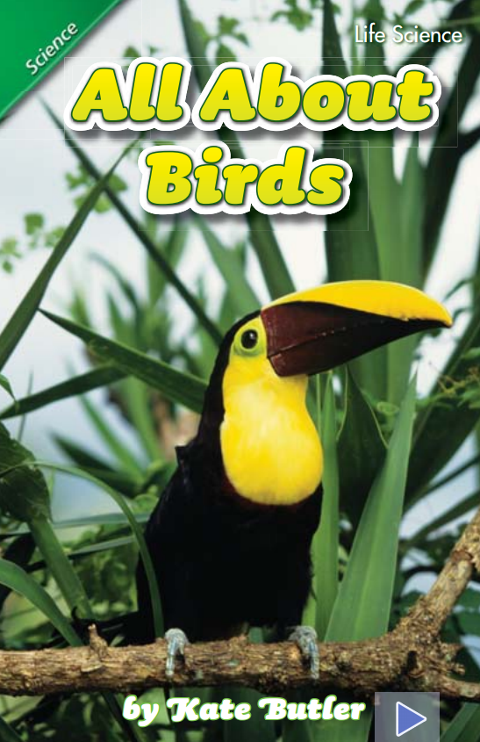
What’s the topic of this book?
How do you know?

Slide 45
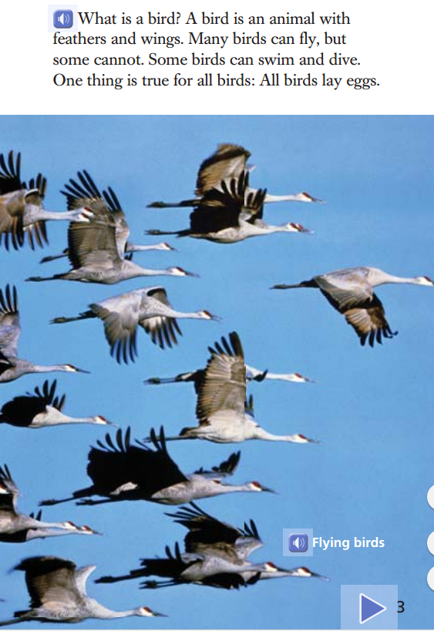
This page is an introduction giving some basic facts about birds.
This book is written in sections, and each section will explain different information about birds.

Slide 46
What ideas and information seem to repeat in this section?
If this section had a heading what could it be?

Slide 47
What ideas and information seem to repeat in this section?
Is there one sentence that seems to tell the main idea?

Slide 49
Tomorrow we will find key details to support the main idea.

Slide 50
Read p. 6-7 The main idea is Birds eat different kinds of food in different ways. What text features are found on p.6-7 of All About Birds? List two text features on that page in your station journal. Next to each feature write how the text feature helps the reader understand the main idea.

